Slide 1
Introduction to Basics of Programming

Slide 2
C++ Tokens

Slide 3
C++ Tokens
Keywords → words that are basically sequence of characters defined by a computer language that have one or more fixed meanings.
- They are also called reserved words.
- Keywords cannot be changed. ex. int, float, do-while, if, else…
Identifiers → words which have to be identified by keywords.
- user defined names. ex. int amount, float avg,…
Operators → +, -, *, %, /, …
Strings → “Manipal”
Constants → -15, 10
Special Symbols → { } (,…

Slide 5
//Program in C++
Comments
These are single line comments.
All lines beginning with two slash signs (//) are considered comments
They do not have any effect on the behavior of the program
The programmer can use them to include short explanations or observations within the source code itself.

Slide 6
#include <iostream>
➢ Lines beginning with a sign (#) are directives for the preprocessor.
➢ They are not regular code lines.
➢ Directive #include<iostream> tells the preprocessor to include the iostream standard header file.
➢ This specified file (iostream) includes the declarations of the basic standard input‐output library in C++, and it is included because its functionality is going to be used later.

Slide 7
main()
➢ The main function is the point where all C++ programs start their execution, independently of its location within the source code.
➢ it is essential that all C++ programs have a main function.
➢ The word main is followed in the code by a pair of parentheses (). That is because it is a function declaration.
➢ Optionally, these parentheses may enclose a list of parameters within them.
➢ Right after these parentheses we can find the body of the main function enclosed in braces{ }.

Slide 8
Simple C++ Program
// Display “This is my first C++ program”
// Single line comment
#include <iostream>
using namespace std; // # is preprocessor directive
main( ) // Entry point for program execution
{
// block of statements:
cout << “This is my first C++ program”;
// block of statements:
}
Notes:
namespace std{ ostream cout; istream cin; //......};

Slide 9
All of the standard library definitions are inside the namespace std. That is they are not defined at global scope, so in order to use them you need to qualify them in one of the following way:
std::cout
using namespace std
using std::cout
#, it is called a "preprocessor directive". The preprocessor reads your program before it is compiled and only executes those lines beginning with #. The preprocessor sets up your source code for the compiler.
The #include directive causes the preprocessor to include the contents of another file into the program.

Slide 10
Simple C++ Program
#include<iostream>
using namespace std;
int main()
{
cout<<"Enter Roll Number and marks of three subjects";
int RollNo,marks1,marks2,marks3;
float minimum = 35.0;
cin>>marks1>>marks2>>marks3;
avg = (marks1+marks2+marks3)/3;
if (avg < minimum )
cout<<RollNo<<"fail";
else
cout<<RollNo<<"pass";
return 0;
}

Slide 11
Program to read and display a number
#include<iostream>
using namespace std;
int main() { //program body begins
int number; //variable declaration
cout<<"enter number"; // user friendly info display
cin>>number; // reading or input value to the variable
cout<<"\nthe no. is\n"<<number; //writing or output variable value
return 0;
} // end of program

Slide 12
C++ decision making and branching statements
1. if Statement
2. switch statement

Slide 13
if statement
➢Used to control the flow of execution of statements.
➢It’s a Two-way decision statement, used in conjunction with an expression.
- It takes the form: if(test expression)
➢It allows to evaluate the expression first and then, depending on the value- true or false, it transfers the control to a particular statement.
i.e. Two-way branching

Slide 14
Different forms of if statement
1. Simple if statement.
2. if…else statement.
3. Nested if…else statement.
4. else if ladder.

Slide 15
Simple if Statement
General form of the simplest if statement:
if (test Expression)
{
statement‐block;
}
statement_x;

Slide 16
If else statement

Slide 17
Nesting of if-else Statements

Slide 18
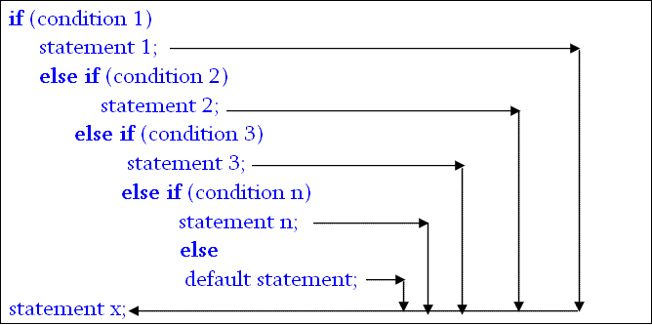
else if Ladder

Slide 19
switch Statement
Switch is multiple–branching statement - based on a condition, the control is transferred to one of the many possible points.
The most flexible control statement in selection structure of program control.
Enables the program to execute different statements based on an expression that can have more than two values. Also called multiple choice statements.

Slide 20
General form:
switch(expression)
{
case value_1 : statement(s);
break;
case value_2 : statement(s);
break; ...
case value_n : statement(s);
break;
default : statement(s);
}
next_statement;

Slide 21
switch- example

Slide 22
Decision Making and Looping Control Structures
Iterative (repetitive) control structures are used to repeat certain statements for a specified number of times.
The statements are executed if the condition is true
These kind of control structures are also called loop control structures
Three kinds of loop control structures:
while
do while
for

Slide 23
While statement
Basic format:
while (test condition)
{
body of the loop
}
✓ Entry controlled loop statement
✓ Test condition is evaluated & if it is true, then body of the loop is executed.
✓ After execution, the test condition is again evaluated & if it is true, the body is executed again.
✓ This is repeated until the test condition becomes false, & control transferred out of the loop.
✓ Body of loop may not be executed if the condition is false at the very first attempt.

Slide 24
Do - While statement
General form:
do
{
body of the loop
}
while (test condition);

Slide 25
for statement
The general form:
for (initialization; test condition; increment)
{
Body of the loop
}
Next statement;

Slide 26
Nesting of for loop
One for statement within another for statement.
for (i=0; i< m; ++i)
{…..
….
for (j=0; j < n;++j)
{……
…..
} // end of inner ‘for’ statement
}// end of outer ‘for’ statement

Slide 27
Jumping out of a loop
• An early exit from a loop can be accomplished by using the break statement.
• When the break statement is encountered inside a loop, the loop is immediately exited & the program continues with the statement immediately following the loop.
When the loops are nested , the break would only exit from the loop containing it.
i.e., the break will exit only a single loop.

Slide 28
Exiting a loop with break statement

Slide 29
Skipping a part of loop
Skip a part of the body of the loop under certain conditions
Using continue statement.
As the name implies, causes the loop to be continued with next iteration, after skipping rest of the body of the loop.

Slide 30
Tutorial
Check if a given number is prime or not
Factorial of given 10 numbers(do not use arrays)
Print all odd numbers between m and n
Menu driven program to sum all elements entered up to -1
Find sin(x) using series.
6. Find cos(x) using series
7. Find e^{x} using series
8. Print triangle in the following
form using loops until n.
Ex. If n=6
1
2 3
4 5 6

Slide 31
Arrays
An array is a group of related data items that share a common name.
The array elements are placed in contiguous memory locations.
A particular value in an array is indicated by writing an integer number called index number or subscript in square brackets after the array name.
The least value that an index can take in array is 0.

Slide 32
Arrays
Array Declaration:
type name [size];
where type is a valid data type (like int, float...), name is a valid identifier & size specifies how many elements the array must contain.
size field is always enclosed in square brackets [ ] and takes static values.
For example
an array salary containing 5 elements is declared as follows:
int salary [5];

Slide 33
Arrays
One Dimensional Array
A linear list of fixed number of data items of same type.
These items are accessed using the same name using a single subscript. E.g., salary [1], salary [4]
A list of items can be given one variable name using only one subscript and such a variable is called a single-subscripted variable or a one-dimensional array.

Slide 34
Arrays
Initializing one-dimensional array (compile time)
type array‐name [size]={list of values}
type→ basic data type
array‐name→ name of the array.
size→ maximum number of elements and may be omitted.
List of values→ values separated by commas.
E.g., int number[3] ={ 0,0,0} or {0} will declare the variable number as an array of size 3 and will assign 0 to each element

Slide 35
Searching & Sorting

Slide 36
Bubble sort

Slide 37
Bubble sort

Slide 38
Bubble sort

Slide 39
Bubble sort

Slide 40
Selection Sort
Idea:
Find the smallest element in the array
Exchange it with the element in the first position
Find the second smallest element and exchange it with the element in the second position
Continue until the array is sorted
Disadvantage:
Running time depends only slightly on the amount of order in the file

Slide 41
Example
8
4
6
9
2
3
1
1
2
3
4
9
6
8
1
4
6
9
2
3
8
1
2
3
4
6
9
8
1
2
6
9
4
3
8
1
2
3
4
6
8
9
1
2
3
9
4
6
8
1
2
3
4
6
8
9

Slide 42
Selection Sort
Alg.: SELECTION-SORT(A)
n ← length[A]
for j ← 1 to n - 1
do smallest ← j
for i ← j + 1 to n
do if A[i] < A[smallest]
then smallest ← i
exchange A[j] ↔ A[smallest]
8
4
6
9
2
3
1

Slide 43
Insertion Sort
Idea: like sorting a hand of playing cards
Start with an empty left hand and the cards facing down on the table.
Remove one card at a time from the table, and insert it into the correct position in the left hand
compare it with each of the cards already in the hand, from right to left
The cards held in the left hand are sorted
these cards were originally the top cards of the pile on the table

Slide 44
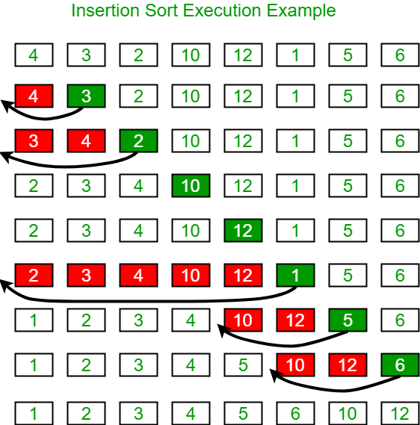
Insertion Sort

Slide 45
Insertion Sort
10
24
To insert 12, we need to make room for it by moving first 36 and then 24.
6
36
12

Slide 46
Insertion Sort
10
24
6
10
24
6
36
12
12

Slide 47
Insertion Sort
6
10
24
36
12

Slide 48
Insertion Sort
input array
5 2 4 6 1 3
at each iteration, the array is divided in two sub-arrays:
left sub-array
right sub-array
sorted
unsorted

Slide 49
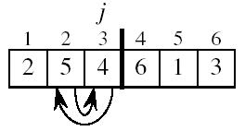
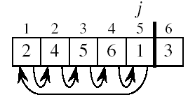
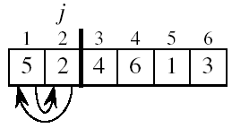
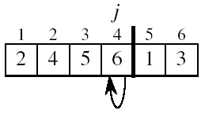
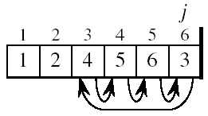
Insertion Sort

Slide 50
Insertion Sort
Alg.: INSERTION-SORT(A)
for j ← 2 to n
do key ← A[ j ]
Insert A[ j ] into the sorted sequence A[1 . . j -1]
i ← j - 1
while i > 0 and A[i] > key
do A[i + 1] ← A[i]
i ← i – 1
A[i + 1] ← key
Insertion sort – sorts the elements in place
1
2
3
4
5
6
7
8
a₁
a₂
a₃
a₄
a₅
a₆
a₇
a₈
key

Slide 51
Insertion Sort
void insertion_sort(int A[], int n)
{
int i, j;
int key;
for (j=1; j<n; j++) {
key = A[j];
for (i=j-1; i>=0&&A[i]>key;i--)
A[i+1] = A[i];
A[i+1] = key;
}
}

Slide 52
Linear search

Slide 53
Linear Search - Example

Slide 54
Linear Search - Example

Slide 55
Linear Search

Slide 56
Binary Search

Slide 57
Binary Search - Example

Slide 58
Binary Search - Example

Slide 59
Binary Search - Example

Slide 60
Binary Search - Example

Slide 61
Procedure

Slide 62
TRACING binary search array: 58 62 75 88 92 105 key: 62
do { mid=(low+high)/2; If(key<a[mid]) high=mid-1; else if(key>a[mid]) low=mid+1; }while(key!=a[mid]&&low<=high);
 | Statement | values | remarks
Initialization | low=0; high=n-1 | low=0;high=5
First Iteration | mid=(low+high)/2; | mid=2 | mid is an int variable
 | If(key<a[mid]) high=mid-1; | 62<75 (a[mid] or a[2] is 75) is True high=1 (mid-1)
 | else if(key>a[mid]) low=mid+1; | else if not executed
 | Condition check : condition 1 (a[mid]!=key) condition 2 (low<=high) | a[2]!=62 is True 0<=1 is True
Second Iteration | mid=(low+high)/2; | mid=0 [(0+1)/2]
 | If(key<a[mid]) high=mid-1; | 62<58 (a[mid] or a[0] is 58) is False
 | else if(key>a[mid]) low=mid+1; | 62>58 (a[mid] or a[0] is 58) is True low=1 (low=mid+1)
 | Condition check : condition 1 (a[mid]!=key) condition 2 (low<=high) | a[0]!=62 is True 1<=1 is True | When low==high, it means the search subarray has single element

Slide 63
TRACING binary search array: 58 62 75 88 92 105 key: 62
do { mid=(low+high)/2; If(key<a[mid]) high=mid-1; else if(key>a[mid]) low=mid+1; }while(key!=a[mid]&&low<=high);
 | Statement | values | remarks
Third Iteration | mid=(low+high)/2; | mid=1 [(1+1)/2] | When low==high, mid will be same as low and high
 | if(key<a[mid]) high=mid-1; | 62<62 (a[mid] or a[1] is 62) is False
 | else if(key>a[mid]) low=mid+1; | 62>62 (a[mid] or a[5] is 105) is False
 | Condition check : condition 1 (a[mid]!=key) condition 2 (low<=high) | a[1]!=62 is False 1<=1 is True | do-while is broken as a[mid!=62 is False. 62 is found in the array, as a[mid]==62 [value of mid is 1, 62 found at the mid position]
low=0; high=n-1
do
{
mid=(low+high)/2;
If(key<a[mid]) high=mid-1;
else if(key>a[mid]) low=mid+1;
}while(key!=a[mid]&&low<=high);

Slide 64
TRACING binary search array: 58 62 75 88 92 105 key: 95
do { mid=(low+high)/2; If(key<a[mid]) high=mid-1; else if(key>a[mid]) low=mid+1; }while(key!=a[mid]&&low<=high);
 | Statement | values | remarks
Initialization | low=0; high=n-1 | low=0;high=5
First Iteration | mid=(low+high)/2; | mid=2 | mid is an int variable
 | If(key<a[mid]) high=mid-1; | 95<75 (a[mid] or a[2] is 75) is False
 | else if(key>a[mid]) low=mid+1; | 95>75 (a[mid] or a[2] is 75) is True low=3 (low=mid+1)
 | Condition check : condition 1 (a[mid]!=key) condition 2 (low<=high) | a[2]!=95 is True 3<=5 is True
Second Iteration | mid=(low+high)/2; | mid=4 [(3+5)/2]
 | If(key<a[mid]) high=mid-1; | 95<92 (a[mid] or a[4] is 92) is False
 | else if(key>a[mid]) low=mid+1; | 95>92 (a[mid] or a[4] is 92) is True low=5 (low=mid+1)
 | Condition check : condition 1 (a[mid]!=key) condition 2 (low<=high) | a[4]!=95 is True 5<=5 is True | When low==high, it means the search subarray has single element

Slide 65
TRACING binary search array: 58 62 75 88 92 105 key: 95
do { mid=(low+high)/2; If(key<a[mid]) high=mid-1; else if(key>a[mid]) low=mid+1; }while(key!=a[mid]&&low<=high);
 | Statement | values | remarks
Third Iteration | mid=(low+high)/2; | mid=5 [(5+5)/2] | When low==high, mid will be same as low and high
 | if(key<a[mid]) high=mid-1; | 95<105 (a[mid] or a[5] is 105) is True high=(mid-1)=4
 | else if(key>a[mid]) low=mid+1; | else if not executed
 | Condition check : condition 1 (a[mid]!=key) condition 2 (low<=high) | a[5]!=95 is True 5<=4 is False | do-while is broken as low<=high is False. 95 is not found in the array, as a[mid]!=95 [value of mid is 5]
low=0; high=n-1
do
{
mid=(low+high)/2;
If(key<a[mid]) high=mid-1;
else if(key>a[mid]) low=mid+1;
}while(key!=a[mid]&&low<=high);

Slide 66
Difference between Linear and Binary Search
Linear Search | Binary Search
Can be applied on sorted and unsorted list of items | Can be applied only on sorted list of items
Searching time is more | Searching time is less

Slide 67
2D Arrays
It is an ordered table of homogeneous elements.
It can be imagined as a two-dimensional table made of elements, all of them of a same uniform data type.
It is generally referred to as matrix, of some rows and some columns.
It is also called as a two‐subscripted variable.

Slide 68
2D Arrays
For example
int marks[5][3];
float matrix[3][3];
char page[25][80];
The first example tells that marks is a 2‐D array of 5 rows and 3 columns.
The second example tells that matrix is a 2‐D array of 3 rows and 3 columns.
Similarly, the third example tells that page is a 2‐D array of 25 rows and 80 columns.

Slide 69
2D Arrays
Declaration
type array_name[row_size][column_size];
For example,
int arr [3][5];
arr represents a two-dimensional array or table having 3 rows
and 5 columns and it can store 15 integer values.

Slide 70
Read a matrix example

Slide 71
Multi – dimensional arrays

Slide 72
